Slide 2
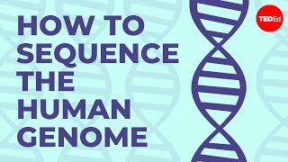
We can read your DNA
Notes:
https://www.youtube.com/watch?v=MvuYATh7Y74

Slide 3
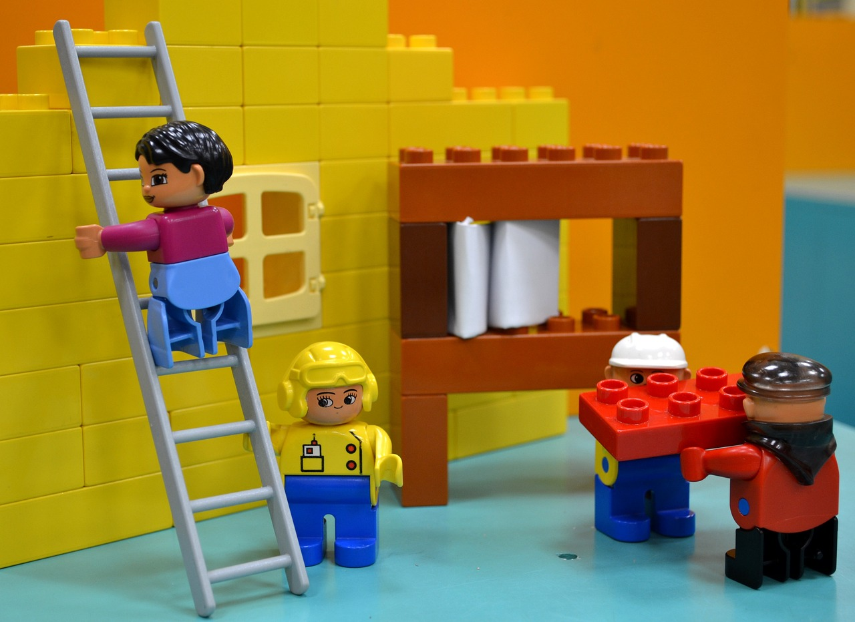
How did we get here?
We didn’t start by sequencing the genome.
Like building with bricks, tens of thousands of scientists contributed their individual work, building off the work before them to learn more and more.
Notes:
Illustrations by sttimm via Pixabay

Slide 4
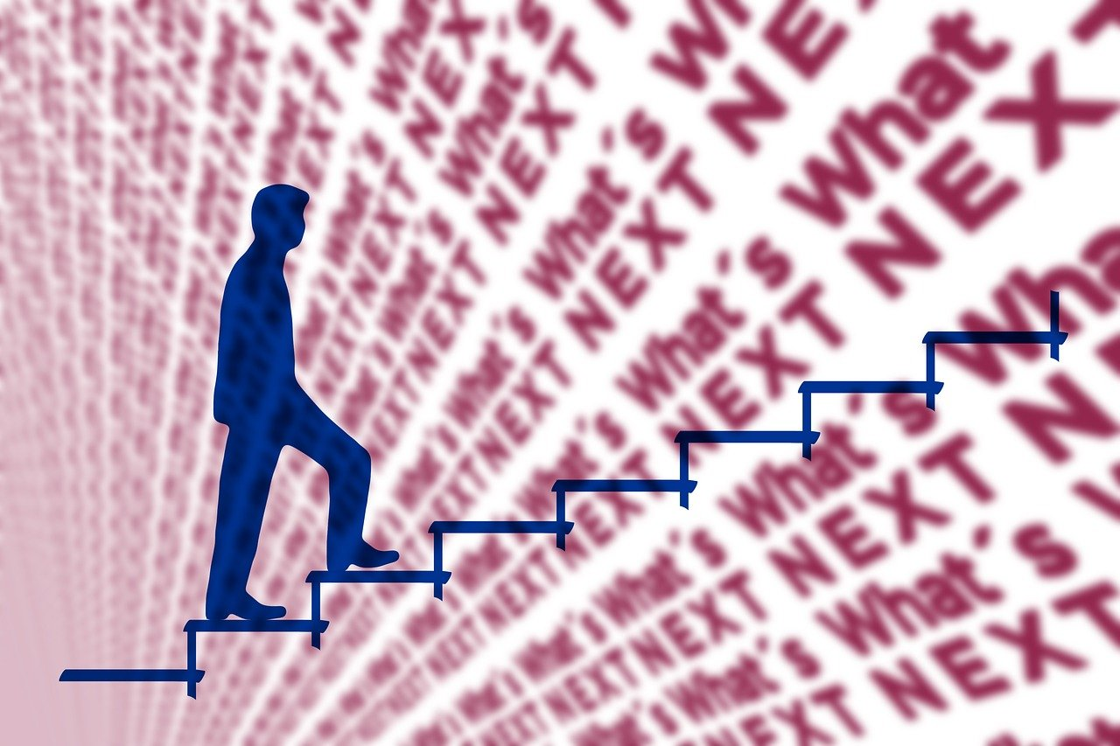
Investigate
You will be given 8 important moments in the field of genetics to research and create a timeline with your shoulder partner.
Use internet resources to find information on each of the listed moments so you can arrange them chronologically.
Hint: Some of these scientists involved may be important again later, so take good notes and save useful resources you find.
Notes:
Illustrations by geralt via Pixabay

Slide 5
Timeline Events
Avery–MacLeod–McCarty experiment discovers that DNA, not proteins, carry genetic information
Rosalind Franklin supervises the creation of the first x-ray diffraction image of a single strand of DNA
Walter Fiers and his team seqence a gene for the first time; it codes for a coat protein of a virus
Transposons, genes that can move up and down the chromosome, are discovered in corn by Barbara McClintock
Gregor Mendel finds that traits are heritable with separate alleles and not via blending
The first draft of the Human Genome Project, a transcription of the entire human genome, is published
Dolly the Sheep is cloned
Charles Darwin proposes the Theory of Evolution

Slide 6
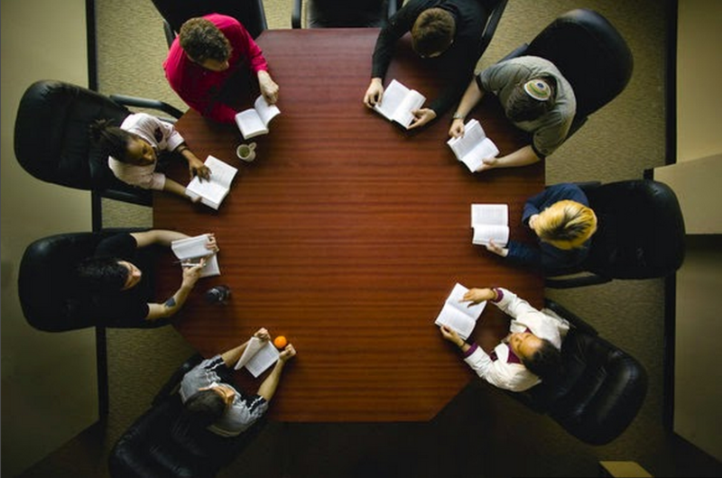
Discussion Questions
Compare your timeline with the other group at your table. Did they find anything different?
Notes:
Have students discuss questions with table group
File:Shimer Class Chicago.PNG - Wikimedia Commons

Slide 7
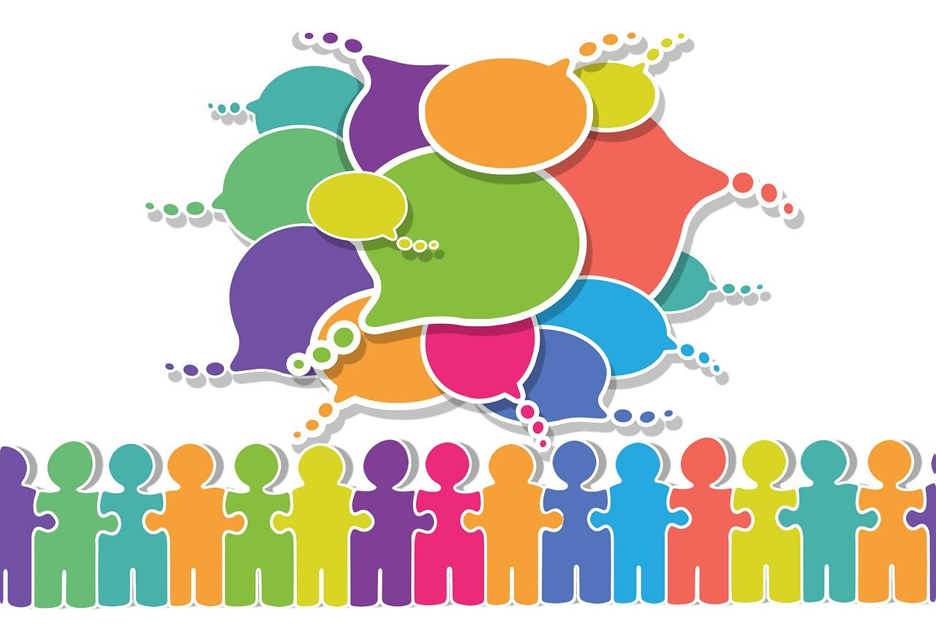
Discussion Questions
Were there any discoveries that surprised you with how early they were? How late?
Is there anything you are interested in learning more about?
Notes:
Have students discuss questions with table group. There is no right or wrong answers for this.
Illustrations by geralt via Pixabay

Slide 8
While there are thousands of scientists that have contributed, there are 4 nominees set to win this year’s DNA Discovery Award
Notes:
Ladies and gentlemen, welcome to the inaugural Golden DNA Award! This prestigious honor celebrates the groundbreaking contributions of scientists who have unlocked the mysteries of DNA and revolutionized our understanding of genetics. Each nominee has left an indelible mark on science and society, pushing the boundaries of discovery and innovation.
Now it’s your turn to play a role in history! Each of you will become an advocate for one of these brilliant scientists. Your mission is to research your chosen nominee and create a persuasive poster that showcases their achievements, contributions to the field, and lasting impact on science and humanity.

Slide 9
Your job is to pick a nominee, research them, and create a campaign poster.
At the end, there will be a poster fair where the class will vote on the winner!

Slide 10
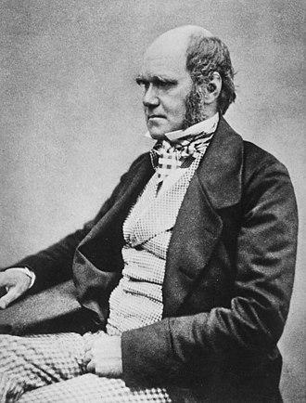
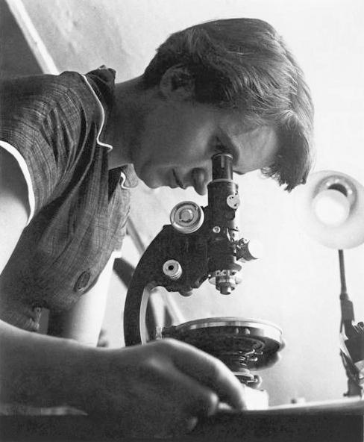
The Nominees - Part 1
Charles Darwin
Rosalind Franklin
Notes:
Allow students to pick one of the scientists to research Please note that Barbara McClintock is far less known than the others, students may have a harder time finding sources on her on popular biography websites, though she has quite a few good biographies available! https://en.wikipedia.org/wiki/Charles_Darwin
https://en.wikipedia.org/wiki/Rosalind_Franklin
https://en.wikipedia.org/wiki/Gregor_Mendel
https://en.wikipedia.org/wiki/Barbara_McClintock

Slide 11
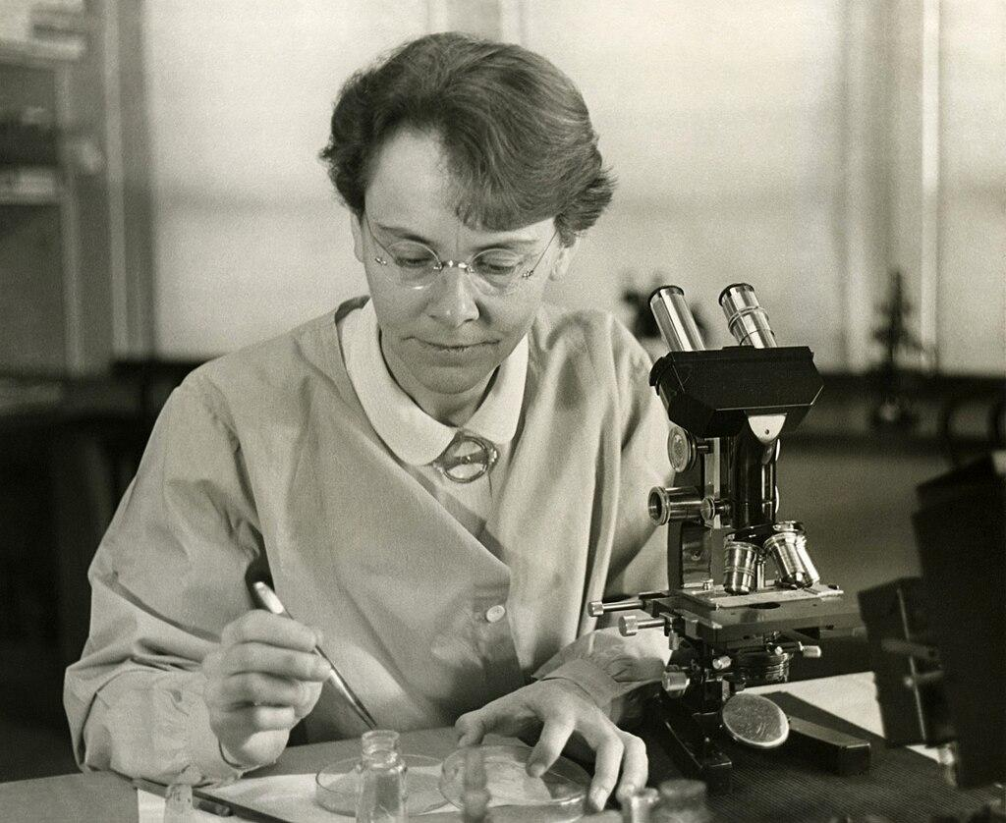
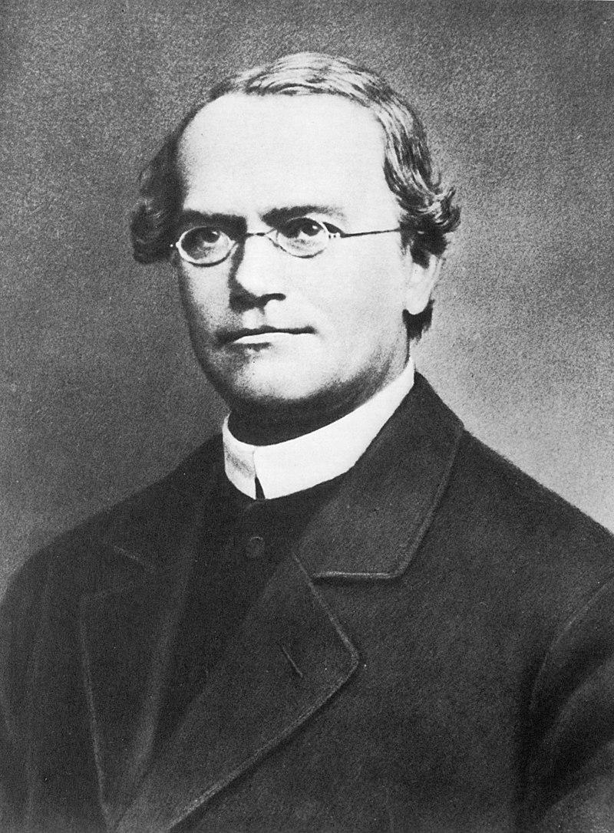
The Nominees - Part 2
Barbara McClintock
Gregor Mendel
Notes:
Allow students to pick one of the scientists to research Please note that Barbara McClintock is far less known than the others, students may have a harder time finding sources on her on popular biography websites, though she has quite a few good biographies available! https://en.wikipedia.org/wiki/Charles_Darwin
https://en.wikipedia.org/wiki/Rosalind_Franklin
https://en.wikipedia.org/wiki/Gregor_Mendel
https://en.wikipedia.org/wiki/Barbara_McClintock

Slide 12
Your task
Content Requirements
Who were they?
When were they born? When did they die?
What did they discover and when?
How did they discover it?
Why was their discovery important?
At least one fun fact unrelated to their discovery.
Other things to Include
Photo or drawing of your nominee
List of sources used in your research
To be turned into teacher;
you do not need to include this on your poster
Notes:
This is the list of all the suggested items on their poster, feel free to add or remove requirements as you see fit.

Slide 13
Work Time
Nominee List
Gregor Mendel
Barbara McClintock
Rosalind Franklin
Charles Darwin
Research
Who were they?
When were they born? When did they die?
What did they discover and when?
Why was their discovery important?
At least one fun fact unrelated to their discovery.
Argument of why they should win
Photo/Drawing
Sources (on a separate paper)
Sources You May Want
References / Citations on Wikipedia page
Books from the library
Biography.com
nobelprize.org
https://askabiologist.asu.edu/explore
Notes:
Leave this page up for students to reference, if students don’t have access to computers, replace “Websites to Visit” with other resources they can browse to find information! You feel free to iterate how much you don’t want wikipedia as a source however strongly you feel is necessary.

Slide 14
TEACHER INFO SLIDE - SLIDE 25 IS NEXT REAL SLIDE
The next few slides are to be used for your reference, in case you need a refresher on any of the nominees, or their discoveries! Additional sources are available for each of the nominees and their discoveries, for you or in case anyone is having difficulties finding sources.

Slide 15
Charles Darwin
12 February 1809 – 19 April 1882
First person to describe the Theory of Natural Selection
Natural selection is the process by which some animals have traits that are better suited to their environment, and thus survive to reproduce and pass those traits on
Spent 5 years traveling the globe on the H.M.S. Beagle, where he observed the similarities and differences between species
Notes:
https://en.wikipedia.org/wiki/Charles_Darwin Good sources in case you need them: https://www.biography.com/scientists/charles-darwin
https://www.nhm.ac.uk/discover/charles-darwin-most-famous-biologist.html
https://www.bbc.co.uk/bitesize/topics/zfj346f/articles/zfbjxg8#zvc2h4j
On natural selection:
https://evolution.berkeley.edu/evolution-101/mechanisms-the-processes-of-evolution/natural-selection/

Slide 16
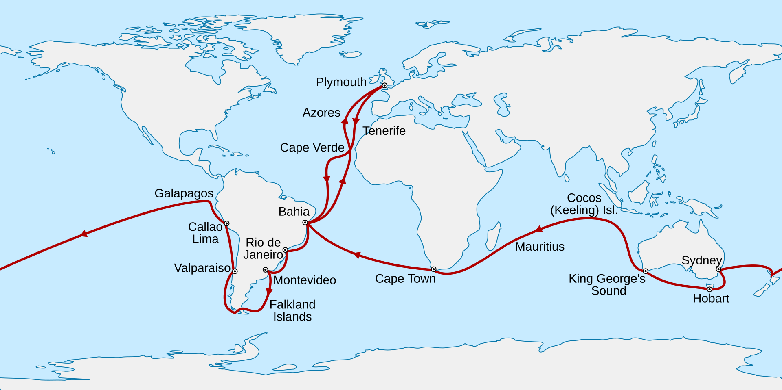
Charles Darwin
Took years after his journey to look through the specimens he collected and talk with others about his findings.
Published On the Origin of Species by Means of Natural Selection November 24, 1859.
Despite this, evolution and natural selection were, and even still are, controversial.
Notes:
https://en.wikipedia.org/wiki/Charles_Darwin
Good sources in case you need them: https://www.biography.com/scientists/charles-darwin
https://www.nhm.ac.uk/discover/charles-darwin-most-famous-biologist.html
https://www.bbc.co.uk/bitesize/topics/zfj346f/articles/zfbjxg8#zvc2h4j
On natural selection:
https://evolution.berkeley.edu/evolution-101/mechanisms-the-processes-of-evolution/natural-selection/

Slide 17
Rosalind Franklin
25 July 1920 – 16 April 1958
A prolific X-ray crystallographer
Most well known for her contribution in discovering the structure of DNA
DNA is very small and has a complex shape, a double helix (like a twisted ladder)
Her coworkers Watson and Crick, who used her photo as reference, won the Nobel Prize but she didn’t
Notes:
https://en.wikipedia.org/wiki/Rosalind_Franklin
Resource on Rosalind Franklin’s life
https://www.biography.com/scientists/rosalind-franklin
https://www.rosalindfranklin.edu/about/facts-figures/dr-rosalind-franklin/

Slide 18
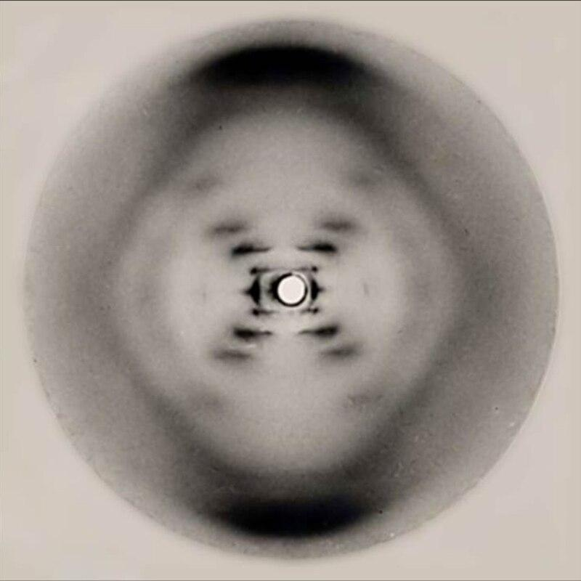
X-ray crystallography
X-ray crystallography is a technique where molecules are crystallized and then x-rays are shot at them, and the patterns in which they bounce off are recorded.
It can be very complex and math intensive to determine what you are looking at, but Rosalind Franklin was an expert at it!
Notes:
https://en.wikipedia.org/wiki/Photo_51
X ray crystallography resource
https://chemistrytalk.org/x-ray-crystallography/

Slide 19
Barbara McClintock
June 16, 1902 – September 2, 1992
First described the crossing over of chromosomes during meiosis; that certain regions of the chromosome correspond to certain genes; and that there are parts of chromosomes that can move, called transposons.
Helped us understand how diversity is created.
Nobody believed her at first, and it took 30 years, for others to confirm her discoveries in the 1960s.
Won the Nobel Prize in 1983.
Notes:
https://en.wikipedia.org/wiki/Barbara_McClintock
Sources:
https://www.nobelprize.org/womenwhochangedscience/stories/barbara-mcclintock
https://profiles.nlm.nih.gov/spotlight/ll/feature/biographical
https://www.cshl.edu/barbara-mcclintock-free-to-discover/

Slide 20
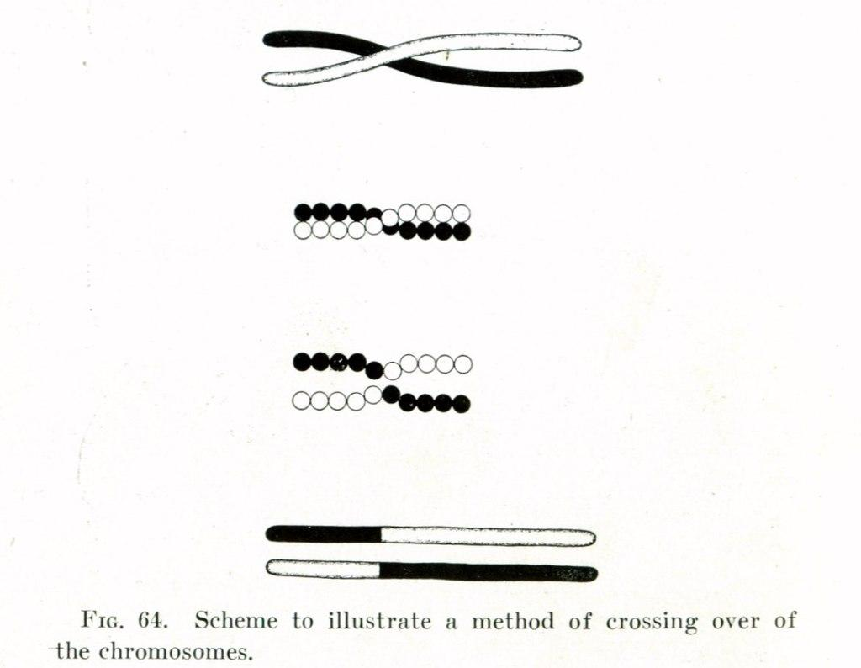
Crossing Over
Before children can inherit genetic information from their parents, the information is randomized.
Parents each have 2 copies of their genes, which one is passed on is random.
Plus, the two copies may “cross over,” exchanging information.
This matters because the copies might have subtle differences!
Notes:
https://en.wikipedia.org/wiki/Chromosomal_crossover
Source on Crossing over
https://www.genome.gov/genetics-glossary/Crossing-Over

Slide 21
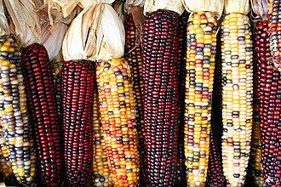
Transposons
Transposons / Transposable elements are small regions of the genome that can move up and down a chromosome
These transposons can cause mutations by inserting in the middle of a gene
This is what caused such color diversity in the corn McClintock was studying!
Notes:
https://de.wikipedia.org/wiki/Barbara_McClintock (HEY ME THIS IS DUTCH WIKIPEDIA. YES CITE THIS SEPERATELY)
Note to teachers:
Transposons are very advanced, especially for your students, this is NOT a standard your students need to know for testing, but it is interesting and may help your students understand how complicated genetics is.
With that said I wish you luck, here are some resources on it
https://bio.libretexts.org/Bookshelves/Biotechnology/Bio-OER_(CUNY)/12%3A_Tracing_Origins/12.05%3A_Transposons

Slide 22
Gregor Mendel
20 July 1822 – 6 January 1884
Discovered that traits are inherited in discrete bundles and not via the blending theory that was popular at the time.
Worked with pea plants and found 3:1 ratios of traits after breeding for multiple generations.
His experiment formed the basis for the understanding of dominant and recessive traits.
Notes:
https://en.wikipedia.org/wiki/Gregor_Mendel Mendel Sources
https://www.biography.com/scientists/gregor-mendel
https://www.nature.com/scitable/topicpage/gregor-mendel-a-private-scientist-6618227/
Mendelian inheritance
https://www.nature.com/scitable/topicpage/gregor-mendel-and-the-principles-of-inheritance-593/

Slide 23
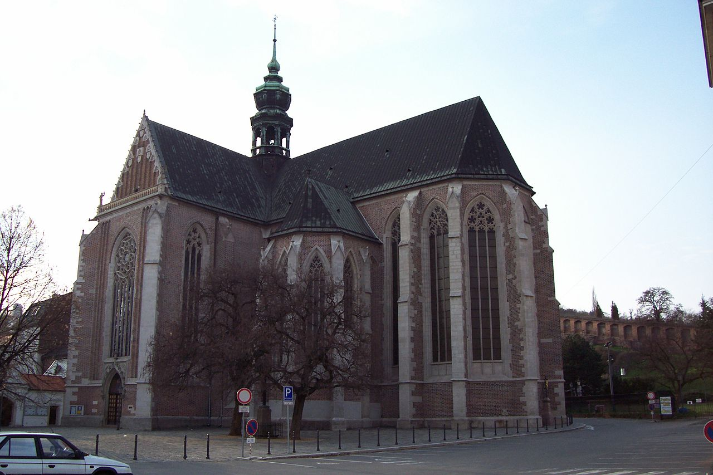
Gregor Mendel
Mendel was a friar at St Thomas's Abbey in the Czech Republic, he was a full time monk, part time scientist!
His pea experiment took seven years to complete, and his boss thought it was a waste of time.
It wasn’t until the 1900s, when others began asking how inheritance worked that his work was recognized.
Notes:
https://en.wikipedia.org/wiki/St_Thomas%27s_Abbey,_Brno
Mendel Sources
https://www.biography.com/scientists/gregor-mendel
https://www.nature.com/scitable/topicpage/gregor-mendel-a-private-scientist-6618227/
Mendelian inheritance
https://www.nature.com/scitable/topicpage/gregor-mendel-and-the-principles-of-inheritance-593/

Slide 24
End of teacher info slides
Notes:
The rest of the slides are designed to be used in your lesson plan

Slide 25
Judging Time
You have 20 minutes to go look at everyone else’s posters
Record the numbers of the posters you like the most
Find your favorite poster for each scientist
Determine who should win the DNA Discovery Award!
Notes:
It’s probably recommended you grade posters after the judging period, but this is a great time to get a quick first pass and get a few done, and ask questions, while students hang up and look at each others posters

Slide 26
Judging Time
Direct students to your version of the judging form (found in the lesson plan and in the speaker's notes) on this slide
Notes:
It’s probably recommended you grade posters after the judging period, but this is a great time to get a quick first pass and get a few done, and ask questions, while students hang up and look at each others posters
https://docs.google.com/forms/d/1pclKjealqGiOcQpTJWnhMRbn7YoTyuiNkxya0-PdMpk/edit
Illustrations by geralt and athree23 via Pixabay

Slide 27
Image Attributions
Slide 3
Illustrations by sttimm via Pixabay
Slide 4
Illustrations by geralt via Pixabay
Slide 7
Illustrations by geralt via Pixabay
Slide 26
Illustrations by geralt and athree23 via Pixabay

