Slide 1
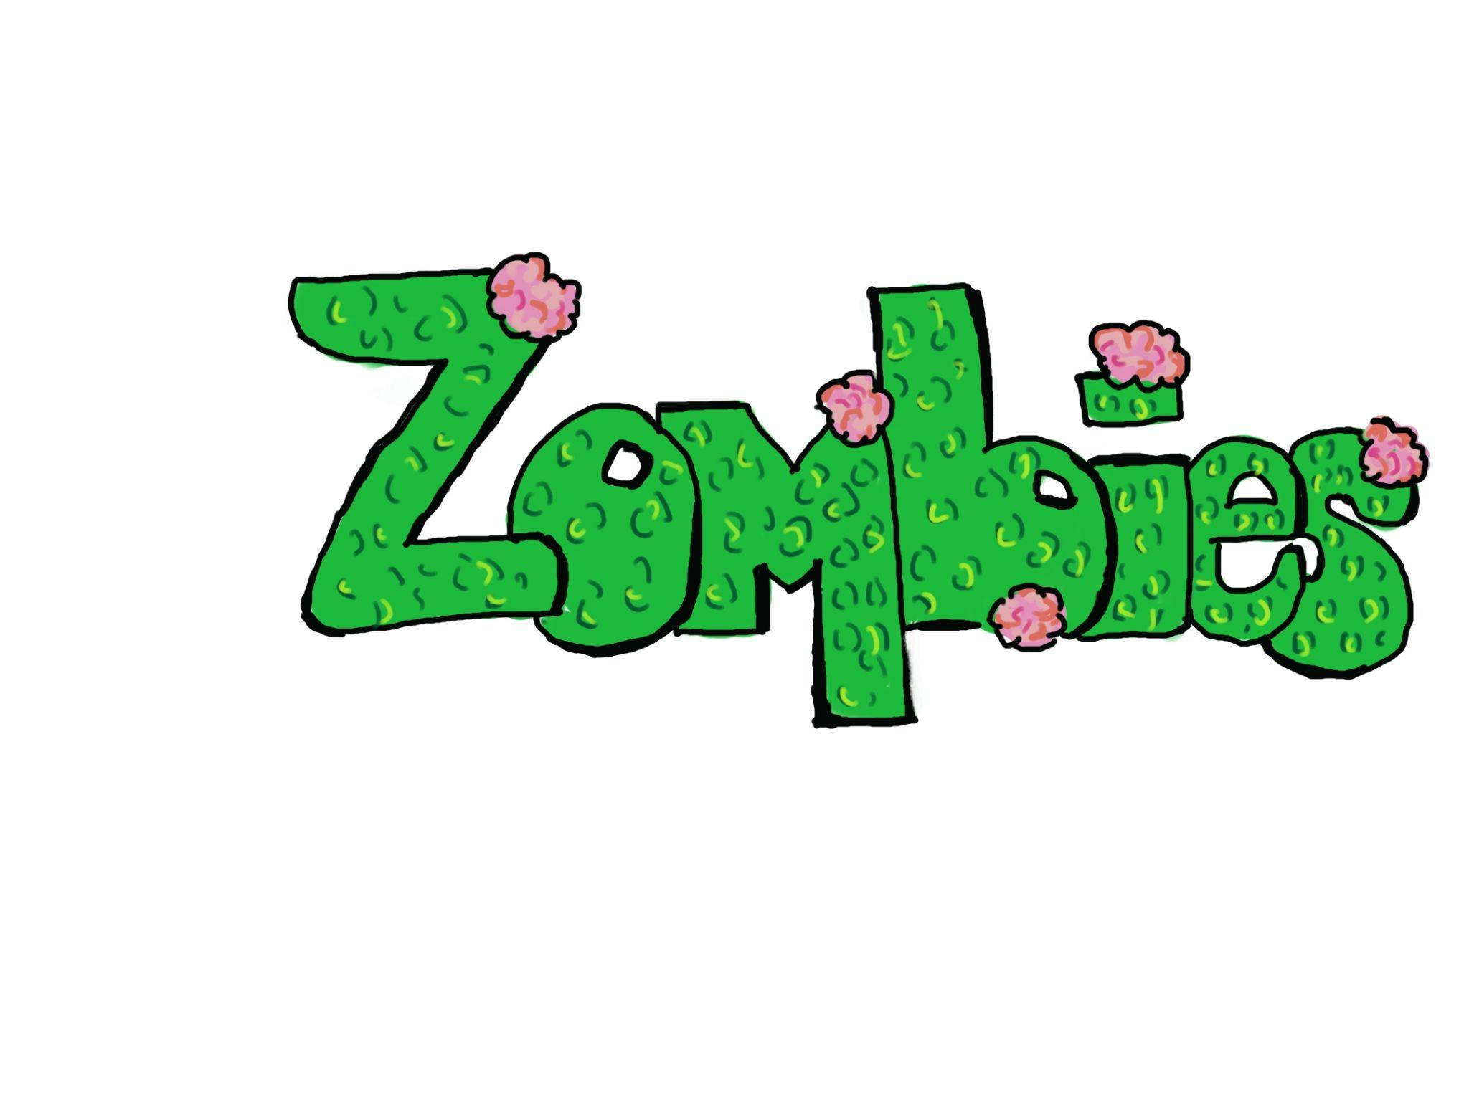
Do they really exist?

Slide 2
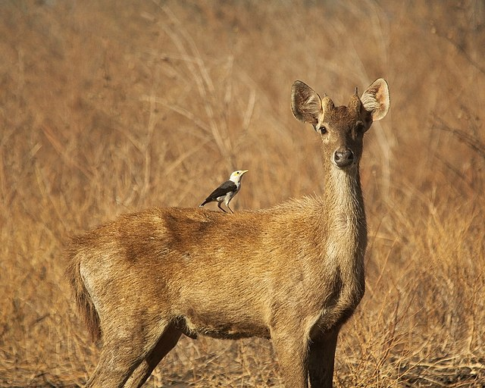
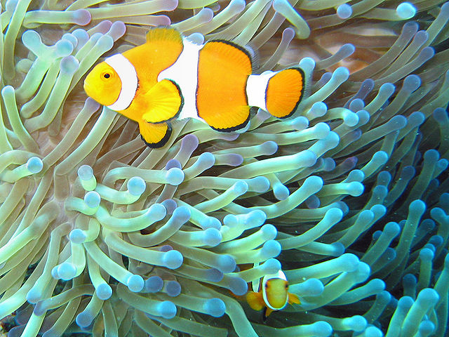
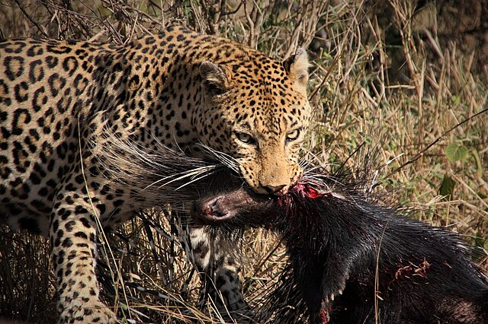
All organisms interact with many other organisms on a daily basis
Notes:
https://commons.wikimedia.org/wiki/File:Common_clownfish.jpg
https://commons.wikimedia.org/wiki/File:Jalak_Putih_Punggung-abu_dan_Rusa_Jawa.jpg
https://commons.wikimedia.org/wiki/File:Needlemouth.jpg

Slide 3
Some interactions are positive while others are negative
Notes:
https://commons.wikimedia.org/wiki/File:Common_clownfish.jpg
https://commons.wikimedia.org/wiki/File:Needlemouth.jpg

Slide 4
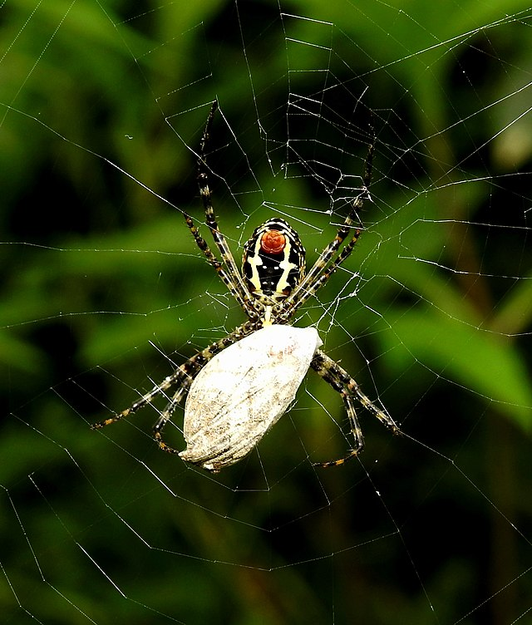
There are 5 main types of species interactions
Predator/Prey
Competition
Mutualism
Commensalism
Parasitism
Notes:
https://commons.wikimedia.org/wiki/File:Signature_Spider_feeding_on_butterfly_by_Dr._Raju_Kasambe_DSCN0064_(1).jpg

Slide 5
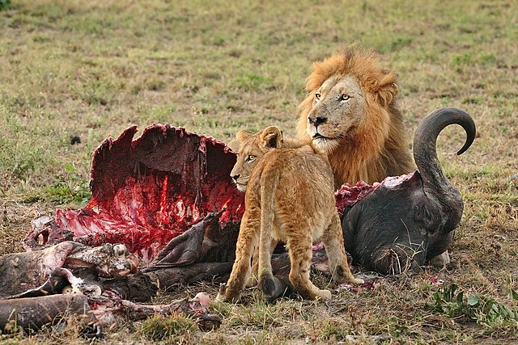
Predator/Prey
This type of interaction exists when one species is the food source for another
Notes:
https://commons.wikimedia.org/wiki/File:Male_Lion_and_Cub_Chitwa_South_Africa_Luca_Galuzzi_2004_edit1.jpg

Slide 6
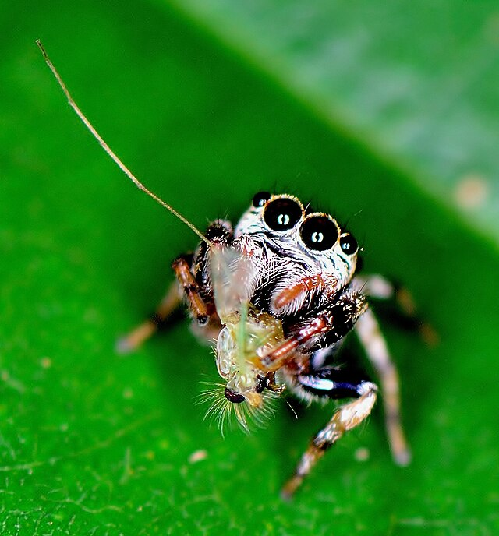
Predator/Prey
Predator: the organism that hunts and kills for food.
Prey: the organism that is hunted and consumed by predator.
Notes:
https://commons.wikimedia.org/wiki/File:Jumping_spider_hugging_its_catch.jpg

Slide 7
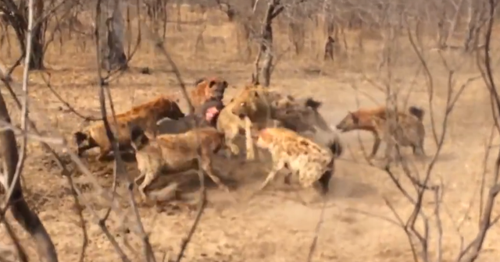
Competition
This type of interaction exists between different organisms or species that are competing over the same resource
(Lion and hyena fighting over carcass)
Notes:
https://commons.wikimedia.org/wiki/File:Hyenas_Fight_Against_Lions_Over_a_Kill_HD_10.png

Slide 8
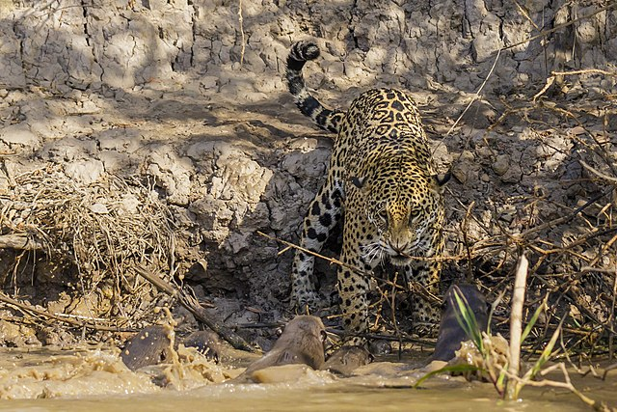
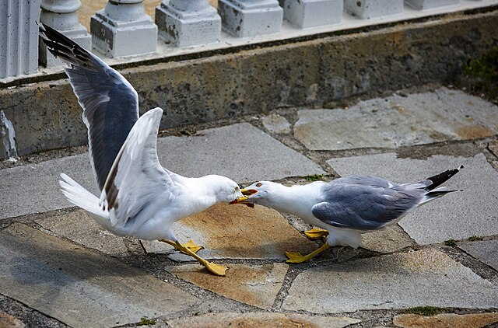
Competition
Intraspecific: competition that occurs between organisms of the same species
Interspecific: competition that occurs between different species
(Otters trying to fight jaguar)
(Seagulls fighting over food)
Notes:
https://commons.wikimedia.org/w/index.php?search=jaguar+and+otters&title=Special%3AMediaSearch&type=image
https://commons.wikimedia.org/w/index.php?search=animals+fighting+over+food+&title=Special%3AMediaSearch&type=image

Slide 9
Mutualism
This type of interaction exists when both species benefit
(Clownfish and sea anemones)
Notes:
https://commons.wikimedia.org/wiki/File:Common_clownfish.jpg

Slide 10
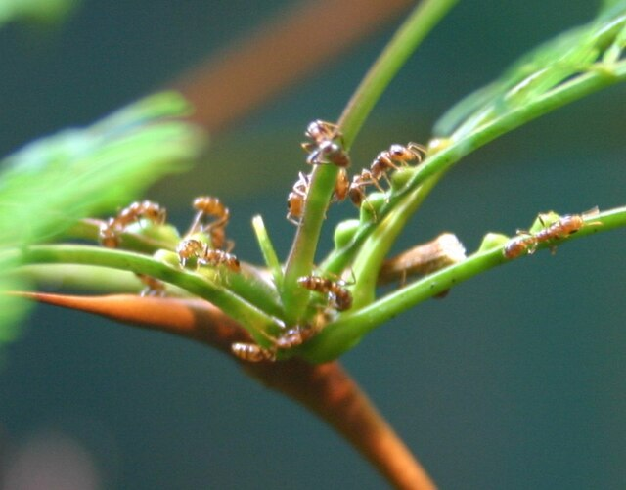
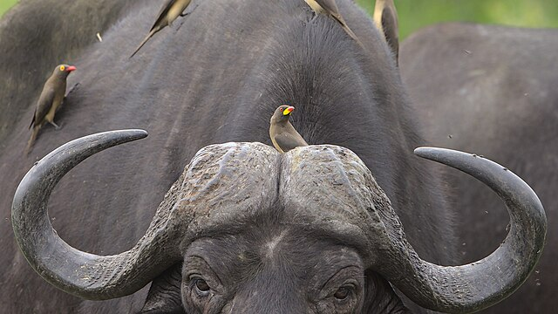
Mutualism
These mutually beneficial relationships can be essential for survival or simply provide advantages without being strictly necessary.
(Ants and acacia trees)
(Oxpecker & large mammals)
Notes:
Acacia trees provide food (nectar and Beltian bodies) and shelter (hollow thorns) for ants. In return, the ants protect the acacia trees from herbivores and competing plants. This relationship is considered obligate because neither species can survive long-term without the other.
Oxpeckers eat ticks and parasites off the herbivores, providing a cleaning service, while the herbivores offer a readily available food source for the oxpeckers. The oxpeckers can also feed on other insects, and the herbivores can survive with parasites, so they are not fully dependent on each other.
https://commons.wikimedia.org/wiki/File:Yellow-billed_oxpecker,_Buphagus_africanus,_on_Cape_buffalo_at_Kruger_National_Park,_South_Africa._-_51753936432.jpg
https://commons.wikimedia.org/wiki/File:Pseudomyrmex_ferruginea_Ryan_Somma-cropped.jpg

Slide 11
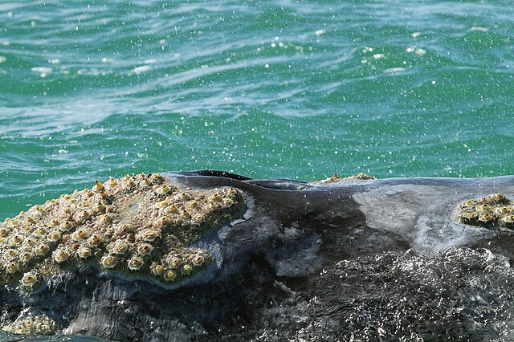
Commensalism
In this type of interaction one species benefits while the other is neither harmed nor helped
(Barnacles on whales)
Notes:
https://commons.wikimedia.org/wiki/File:Whale_barnacles_and_lice.jpg

Slide 12
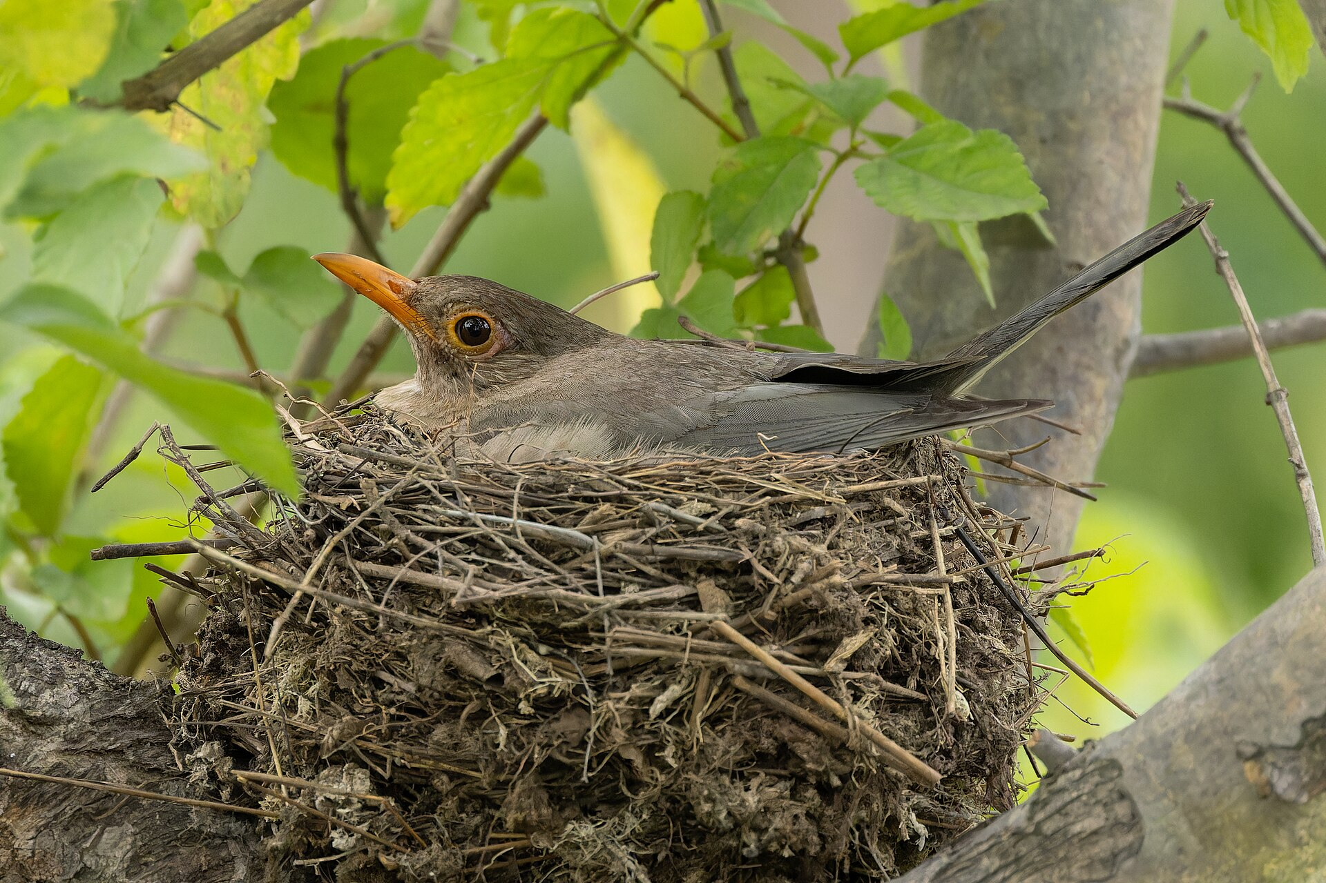
Commensalism
It's a symbiotic relationship where one species gains a benefit like food, shelter, or transportation, while the other species neither benefits nor is harmed
(Bird nesting in a tree)
Notes:
https://commons.wikimedia.org/wiki/File:Indian_Blackbird_in_Saswad_August_2025_by_Tisha_Mukherjee_01.jpg

Slide 13
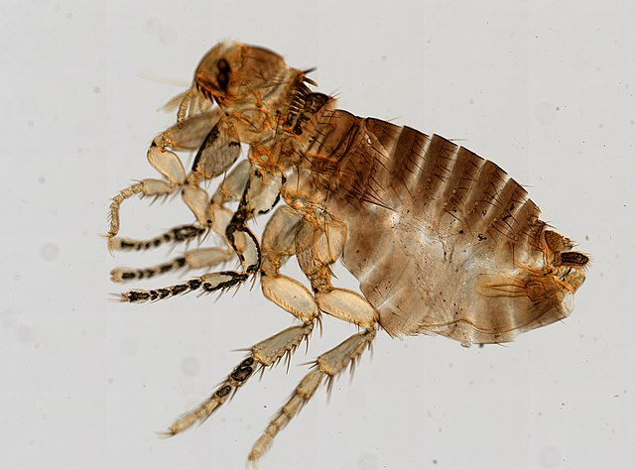
Parasitism
In this type of interaction, one organism will benefit at the expense of another organism.
(Fleas on dogs)
Notes:
https://commons.wikimedia.org/wiki/File:Siphonaptera_(YPM_IZ_093896).jpeg

Slide 14
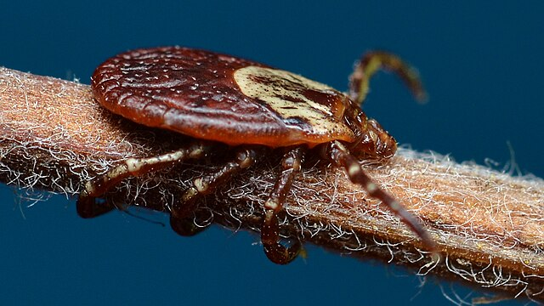
Parasitism
The parasite relies on the host for resources and habitat, while the host experiences negative effects, sometimes leading to illness or even death.
(American Dog tick)
Notes:
File:American Dog Tick (Dermacentor variabilis) - Kitchener, Ontario 2019-06-15 (04).jpg - Wikimedia Commons

Slide 15
But, Hey! I thought we were talking about ZOMBIES?
Zombies that we see in movies, video games, and tv shows don’t exist
But, in nature some forms of parasitism can result in innocent creatures being made into mindless slaves, being forced to create new zombies so that another organism can spread

Slide 16

Let’s Talk about Zombies
How do you know someone is a zombie?
How do you become a zombie?
What do zombies eat?
What is the main purpose of a zombie?
Which movie or show has the best zombies?
Notes:
https://commons.wikimedia.org/wiki/File:MOREmoji_zombie.svg

Slide 17

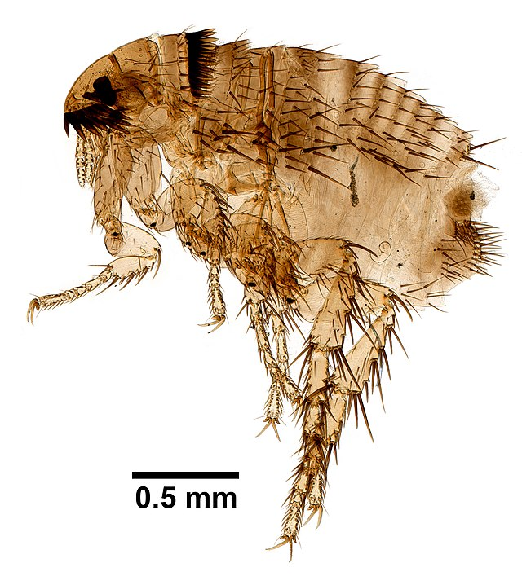
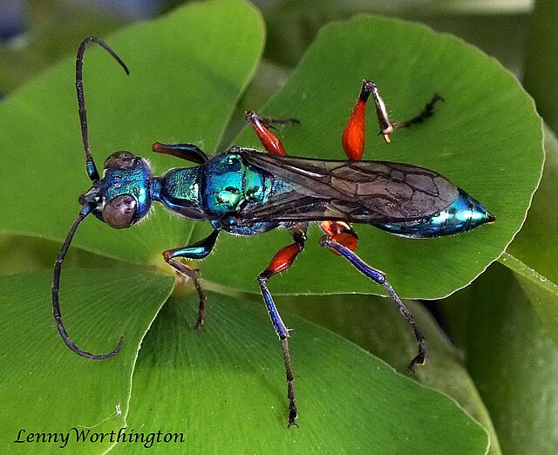
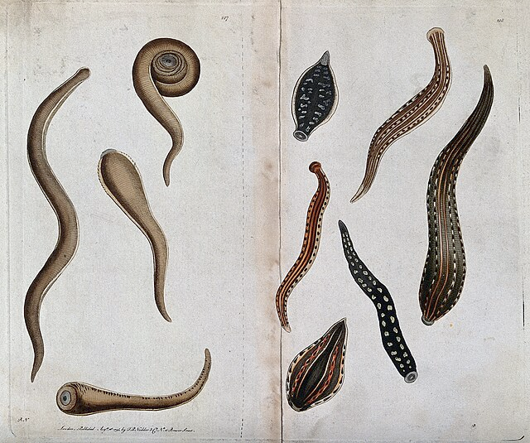
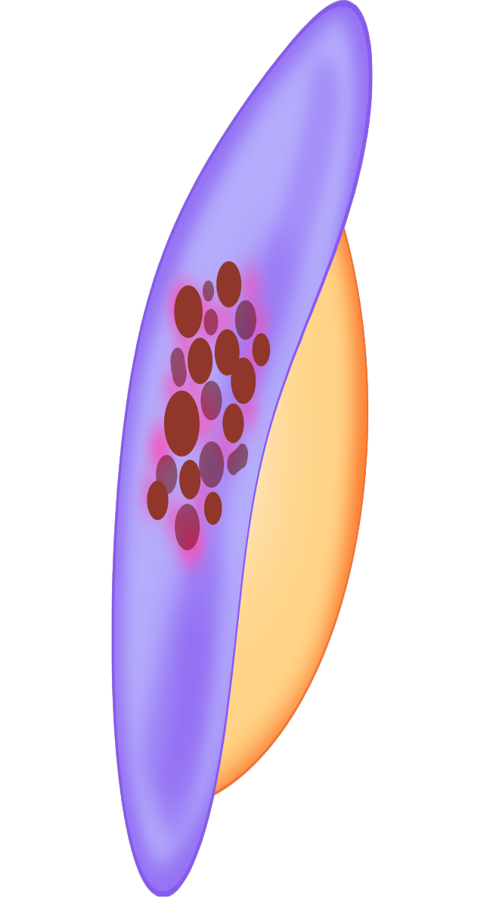
Parasites
Organisms that live inside or on another organism, known as the host, and obtain their nutrients and shelter from it (harming the host) are parasites.
WORMS
VIRUSES & PROTIST
ECTOPARASITES
OTHER INSECTS
Notes:
https://commons.wikimedia.org/wiki/File:Ampulex_compressa_(Fabricius,_1781)_The_Emerald_Cockroach_Wasp_or_Jewel_Wasp_(15683609164).jpg
https://commons.wikimedia.org/wiki/File:Siphonaptera_(YPM_IZ_093862).jpeg
https://commons.wikimedia.org/wiki/File:Virus_purple.svg
https://commons.wikimedia.org/wiki/File:Plasmodium_falciparum_female_stage_V_gametocyte.svg
https://commons.wikimedia.org/wiki/File:Several_species_of_parasitic_flat-worm._Coloured_etching,_ca_Wellcome_V0022497.jpg

Slide 18
What is the main purpose of these parasites?
To continue their life cycle (survive and reproduce) - even at the expense of their host
Sometimes, they take over their host to ensure their survival and to make sure they spread to other creatures - just like zombies!
Let’s look at some examples!

Slide 19
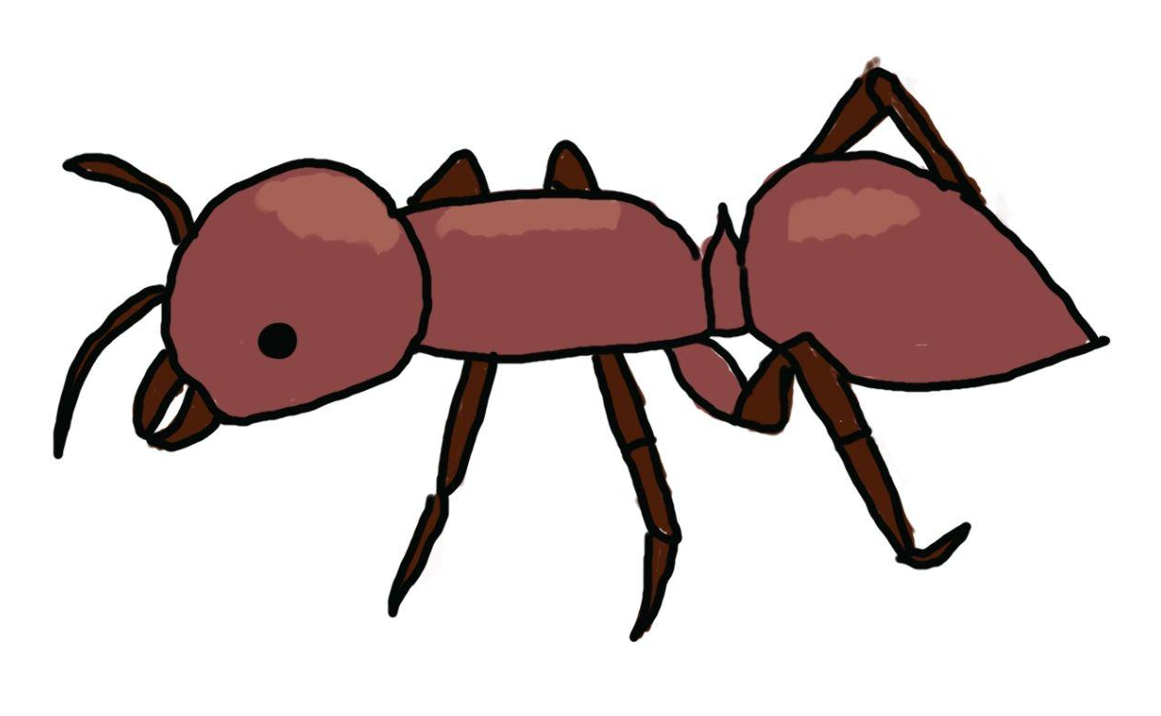
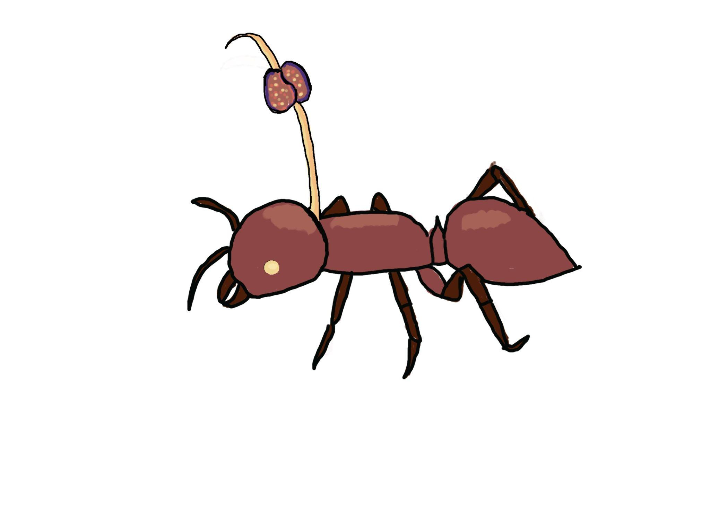
Body-Snatcher Invasion
Zombie maker: The fungus OPHIOCORDYCEPS UNILATERALIS
Nickname: Body Snatcher
Zombie Victim: Carpenter ant (CAMPONOTUS LEONARDA)
Location: Southeast Asia
How it spreads: The fungus begins as a spore. It lands on the carpenter ant and quickly sprouts. The fungus invades the ant’s body and digests the ant’s insides, little by little.

Slide 20
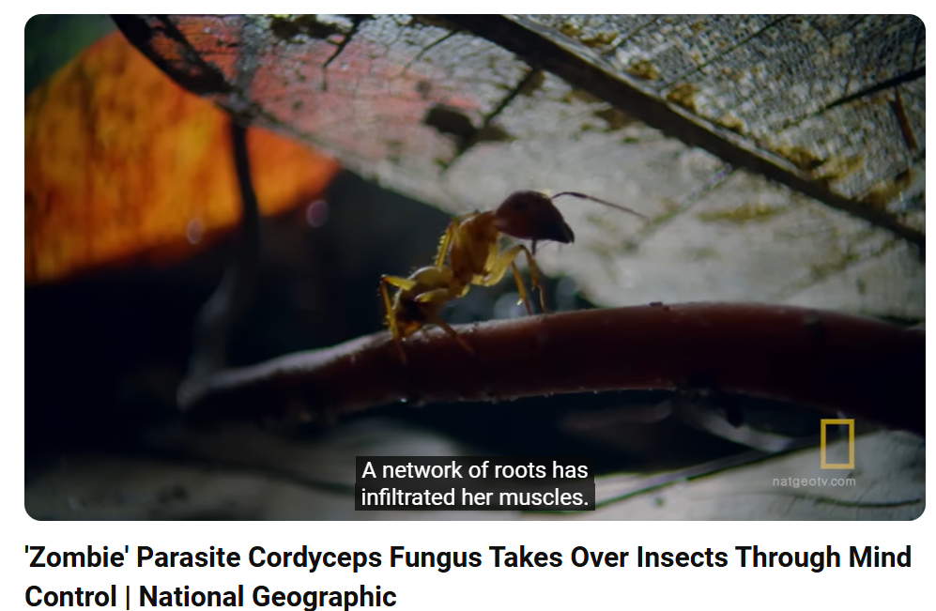
Let’s Watch!
https://youtu.be/vijGdWn5-h8?si=kfxJbkIYsSNWwAZi

Slide 21
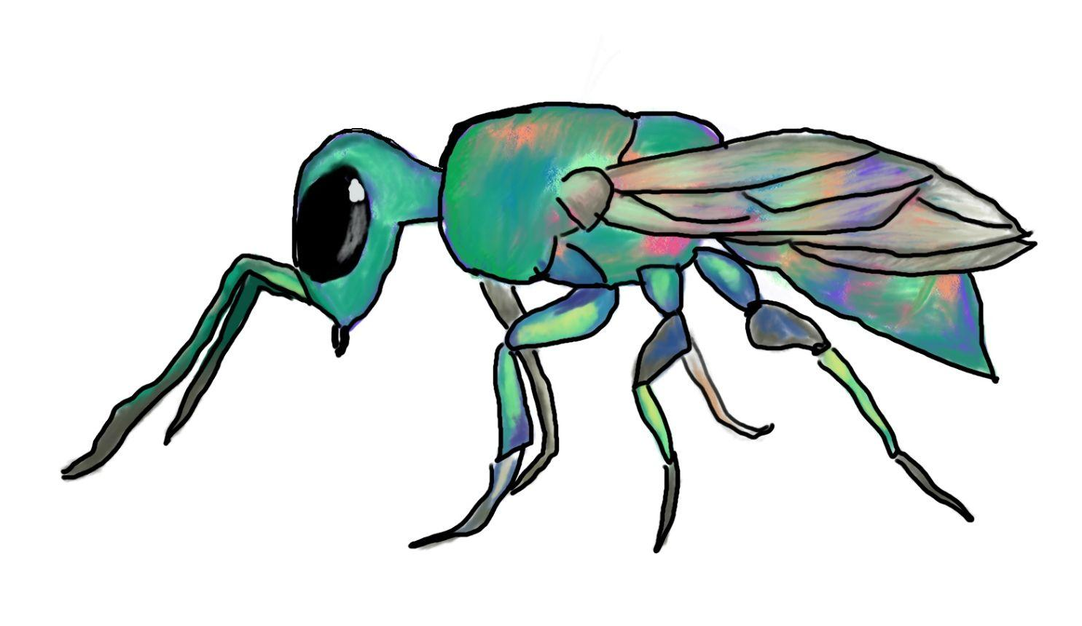
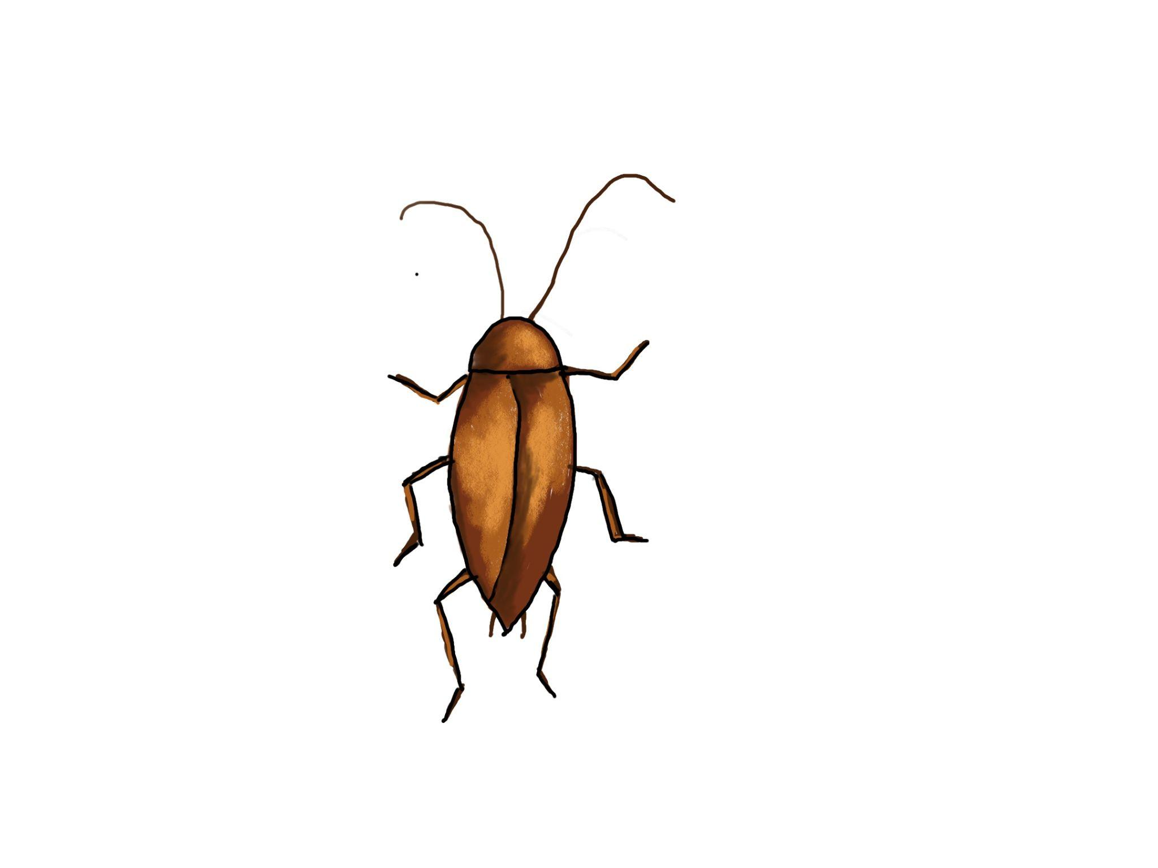
Cockroach Tamer
Zombie maker: The Jewel wasp (AMPULEX COMPRESSA)
Nickname: Cockroach Tamer
Zombie Victim: Cockroaches (PERIPLANETA AMERICANA)
Location: Tropical parts of Africa, South Asia, and The Pacific Islands
How it spreads: The Jewel Wasp injects venom into a cockroach which turns the cockroach into a perfect babysitter.

Slide 22
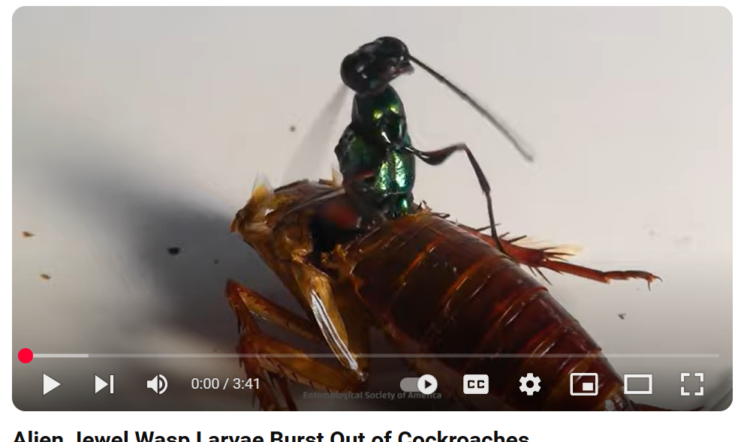
Let’s Watch!
https://youtu.be/d-PtBbDwows?si=z-gEs_6-x4xOOMnU

Slide 23
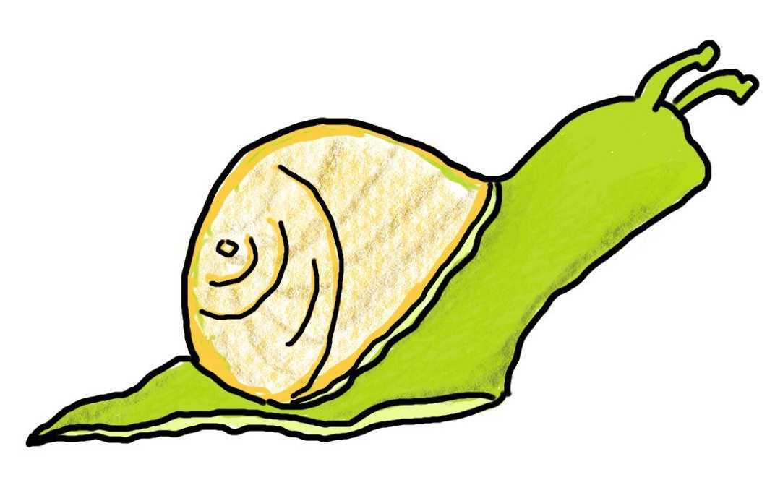
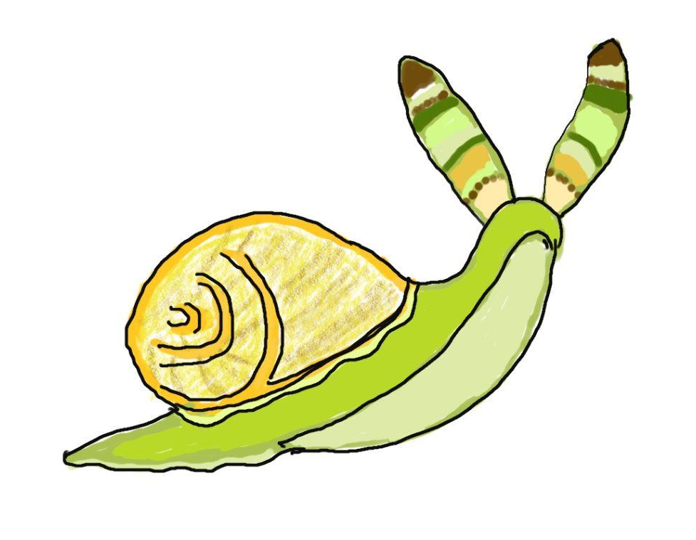
Green-Banded Broodsac
Zombie maker: The flatworm LEUCOCHLORIDIUM PARADOXUM
Nickname: Green-banded broodsac
Zombie Victim: Amber snails (SUCCINEA PUTRIS)
Location: United Kingdom, Europe, Western and Northern Asia
How it spreads: The snail unknowingly eats the flatworm (it's in the bird poop). Once inside the snail it takes over its brain and makes it follow specific instructions so it gets eaten by a bird! It even makes its eyestalks look like worms

Slide 24
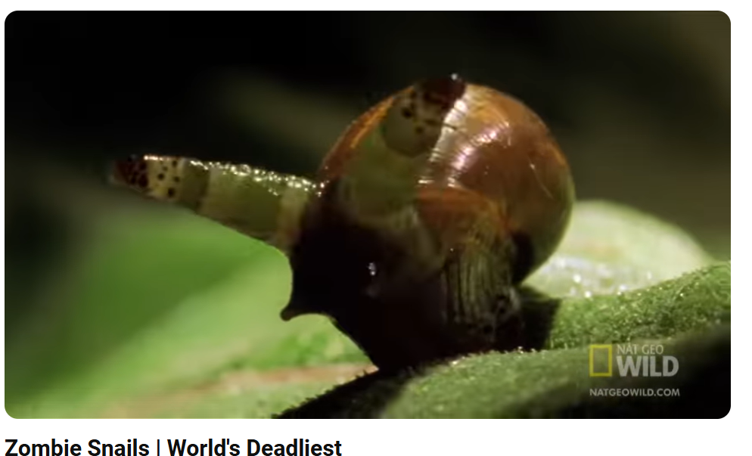
Let’s Watch!
https://youtu.be/Go_LIz7kTok?si=_AgDpGizi0y2YZ9P

Slide 25
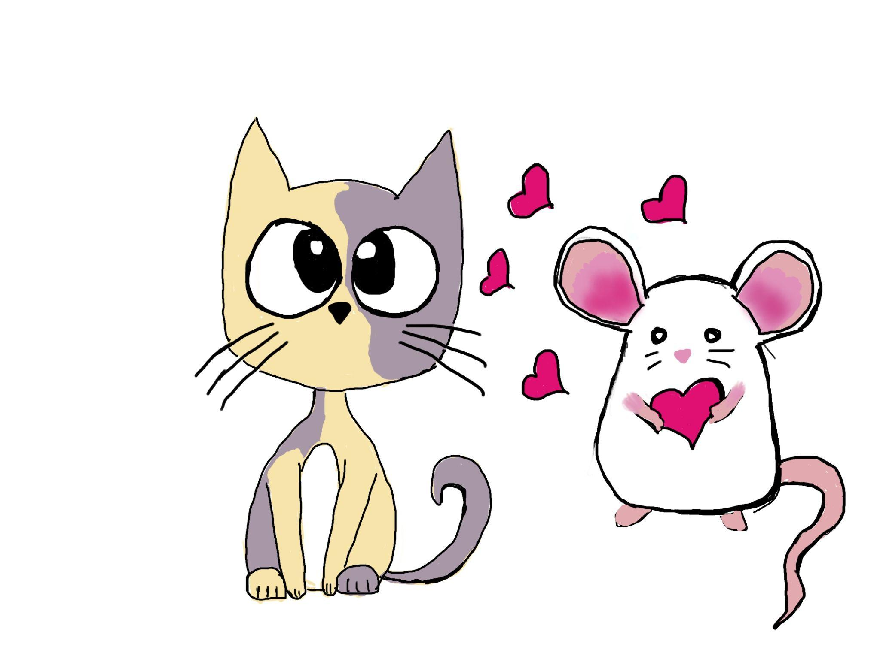
Rat Controller
Zombie maker: The single-celled (protist) parasite (TOXOPLASMA GONDII)
Nickname: Rat Controller
Zombie Victim: Rats and other warm blooded animals
Location: Everywhere cats are found
How it spreads: When a rat eats the waste of an infected cat, it swallows millions of eggs. Eventually the eggs hatch and head for the rats brain. The rat loses its fear of cats and wants to be near them- its in LOVE!

Slide 26
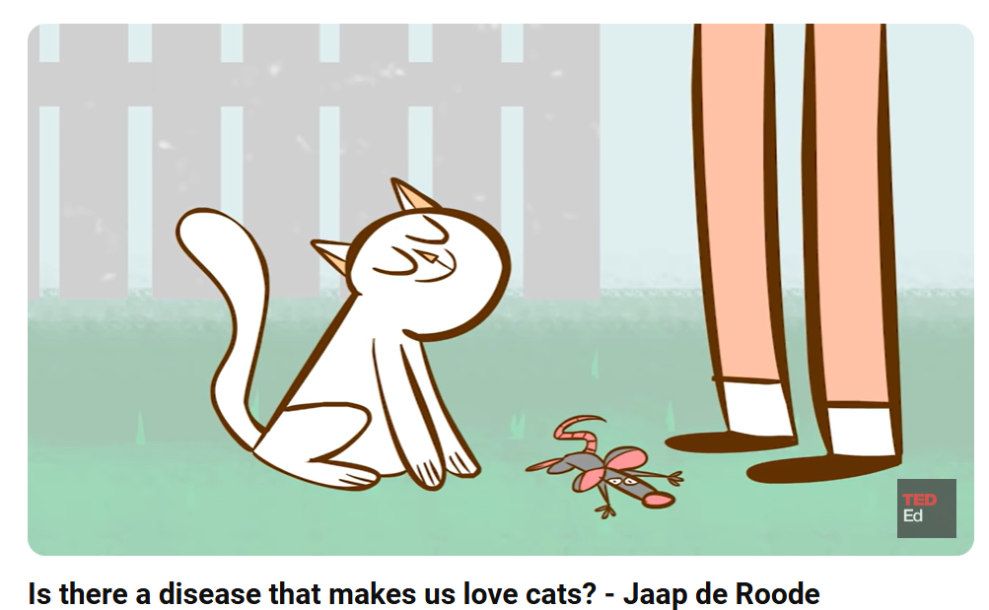
Let’s Watch!
https://youtu.be/rqno7K2zXi4?si=i9yTWfaeX1-rfgx-

Slide 27
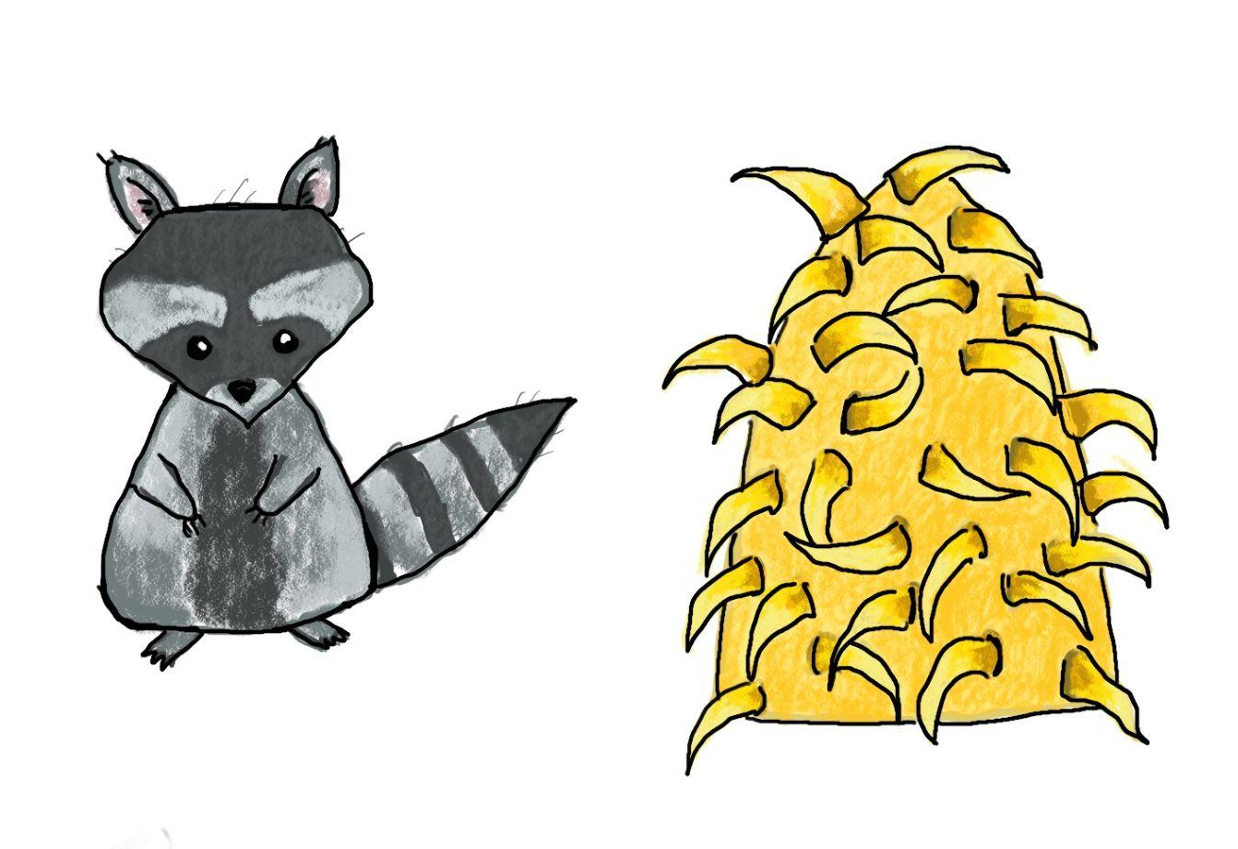
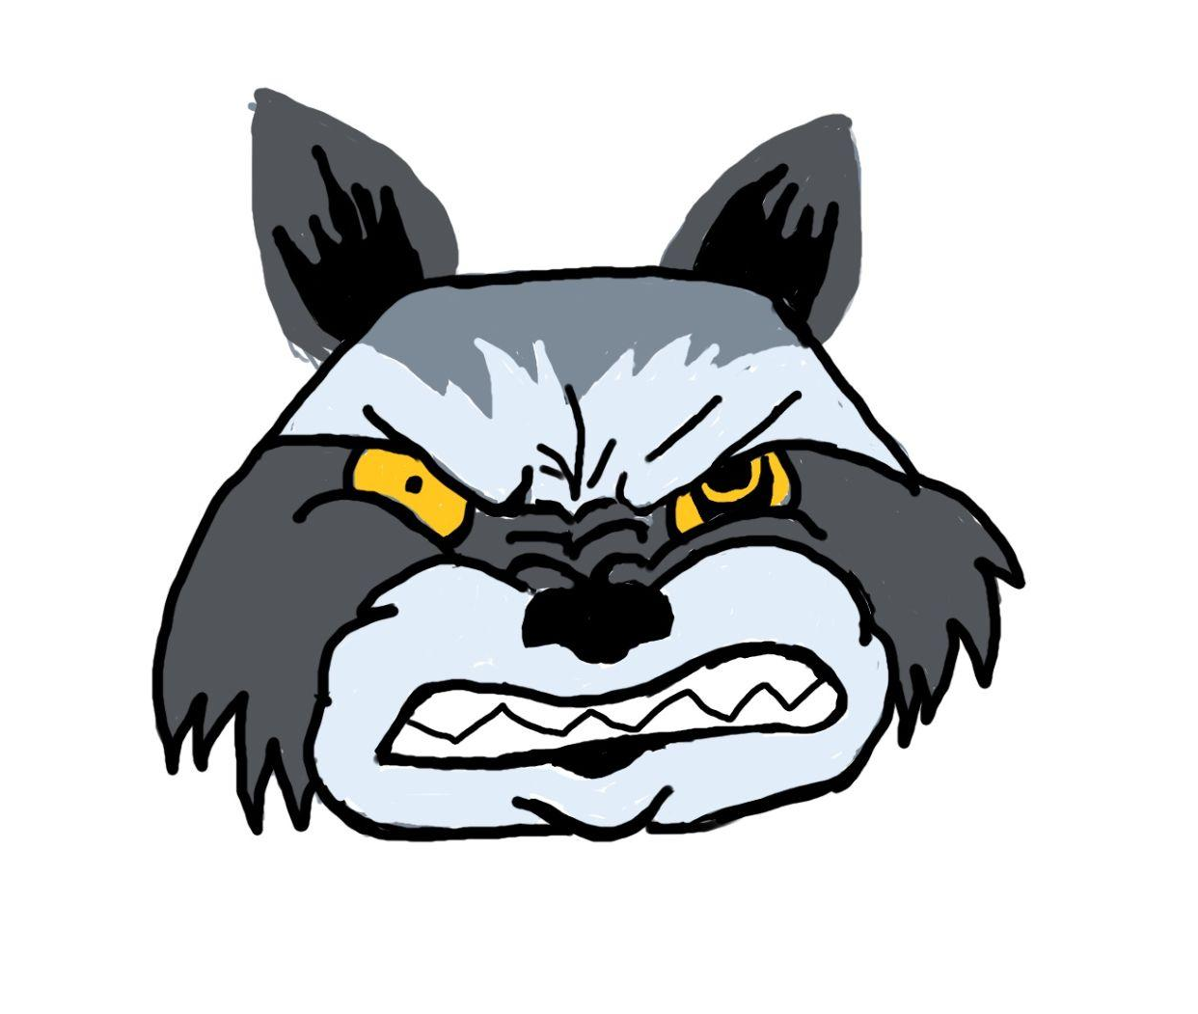
Mad-dog Disease
Zombie maker: The Rabies Virus (RABIES LYSSAVIRUS)
Nickname: Mad-dog Disease
Zombie Victim: Mammals (mostly racoons, skunks, bats, and foxes)
Location: Every country except Australia and New Zealand
How it spreads: A racoon gets bit by an infected bat. The virus makes it into the wound and the virus replicates inside the racoon. The virus soon changes the raccoon’s behavior

Slide 28
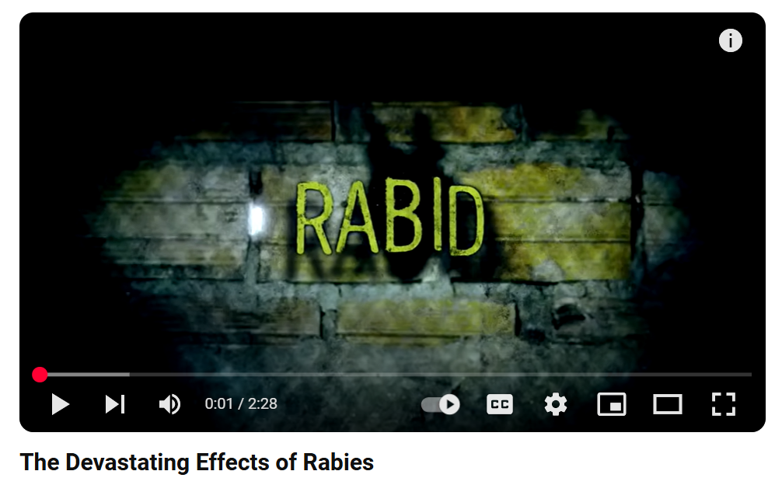
Let’s Watch!
https://youtu.be/kxBIJvNHZg4?si=vuZq2NZfsddSJTVj

Slide 29
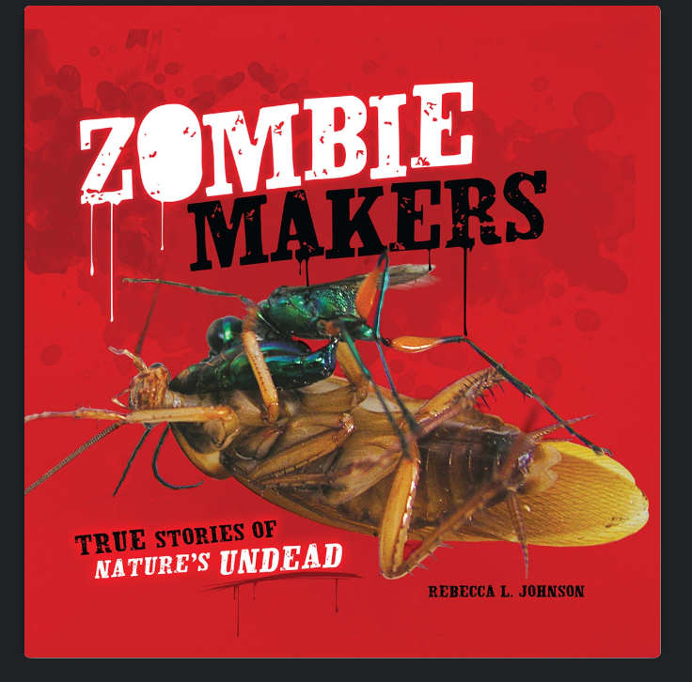
Resource
Great book !
Available at most public libraries
Sometimes available at school libraries

Slide 30
Now it’s your turn!
Work in groups of three
Using the worksheet you will create your own zombie!
Turn it into your teacher by the end of the class.
Use your creativity…think outside the box.
Note: Your zombie victim can be human!

